Slide 1
ADDITION CHATS
By Dr. Nicki Newton

Slide 2
Tell me a story

Slide 3
Tell me a story

Slide 4
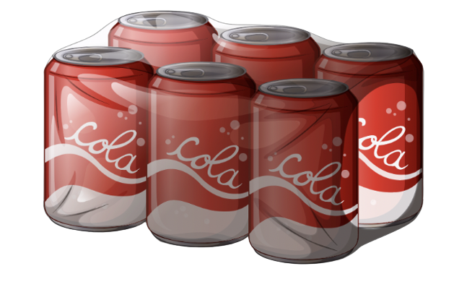
Tell a Story

Slide 5
Tell me a story

Slide 6
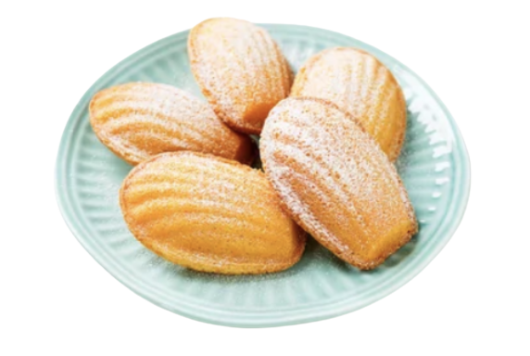
Tell me a story

Slide 7
Tell me a story

Slide 8
Tell me a story

Slide 9
Tell me a story

Slide 10
Tell me a story

Slide 11
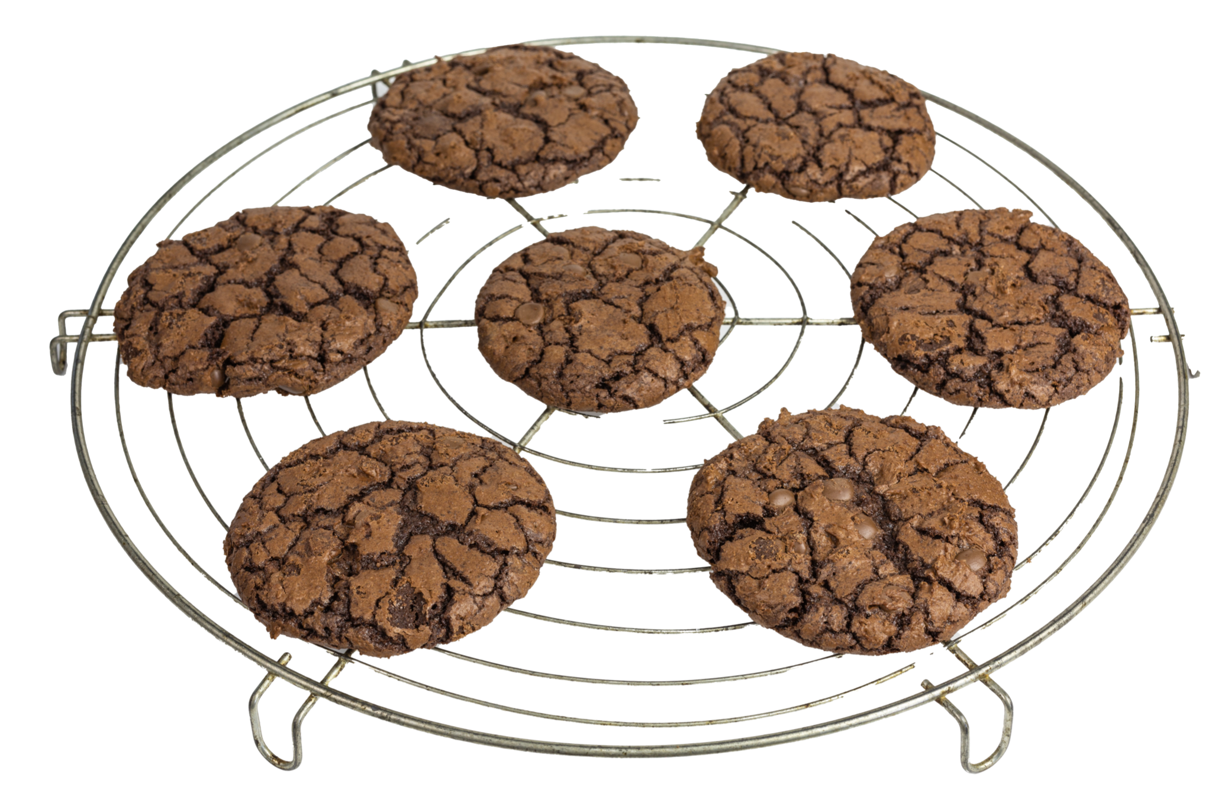
Tell me a story

Slide 12
Tell me a story

Slide 13
Tell me a story

